Slide 1

Building a Production-Ready Cryptocurrency Dashboard with Streamlit
Presented by Krishnan V

Slide 2
OVERVIEW
Project Architecture
Multi-Source Data Provider
Real-Time Dashboard
Data Visualisation
Interactive Streamlit interface with auto-refresh capabilities, customisable refresh intervals, and responsive design for optimal user experience.
Plotly-powered interactive charts supporting multiple cryptocurrencies with configurable time periods from 24 hours to 90 days.
Intelligent fallback system that seamlessly switches between CoinGecko, Binance, and mock data sources to ensure uninterrupted service delivery.

Slide 3





RESILIENCE
Robust Data Pipeline with Intelligent Fallbacks
Primary Source
CoinGecko API with rate limit handling and error detection
Secondary Source
Binance API as automatic fallback with format conversion
Mock Data Generator
Demonstration data when external APIs are unavailable

Slide 4

Smart Caching Strategy
Implementation Benefits
30-second cache duration reduces API calls by up to 95%
Timestamp-based validation ensures data freshness
Separate cache keys for market data, historical prices, and individual cryptocurrency queries
Graceful degradation when cache misses occur

Slide 5
FEATURES
Core Dashboard Capabilities
Market Overview
Interactive Charts
Advanced Filtering
Real-time tracking of top cryptocurrencies with price, 24-hour change, and market capitalisation metrics displayed in an intuitive grid layout.
Multi-cryptocurrency comparison with Plotly visualisations supporting 24-hour, 7-day, 30-day, and 90-day historical price analysis.
Comprehensive search functionality by name or symbol with sortable columns for price, market cap, and percentage changes.

Slide 6
Technical Implementation Deep Dive
Configuration Layer
1
Streamlit page config with wide layout, custom favicon, and expanded sidebar. CSS injection for branded styling with custom colour schemes and responsive typography.
2
Data Provider Class
MultiSourceDataProvider orchestrates API calls with try-except chains, automatic source rotation, and intelligent error handling for 429 rate limits and timeout scenarios.
Dashboard Controller
3
CryptoDashboard class manages UI state, session persistence, and component rendering. Implements tab-based navigation with modular display methods for metrics, charts, and tables.
4
Auto-Refresh System
Time-based rerun logic with configurable intervals (10-300 seconds) and countdown display. Session state management prevents data loss during refreshes.

Slide 7
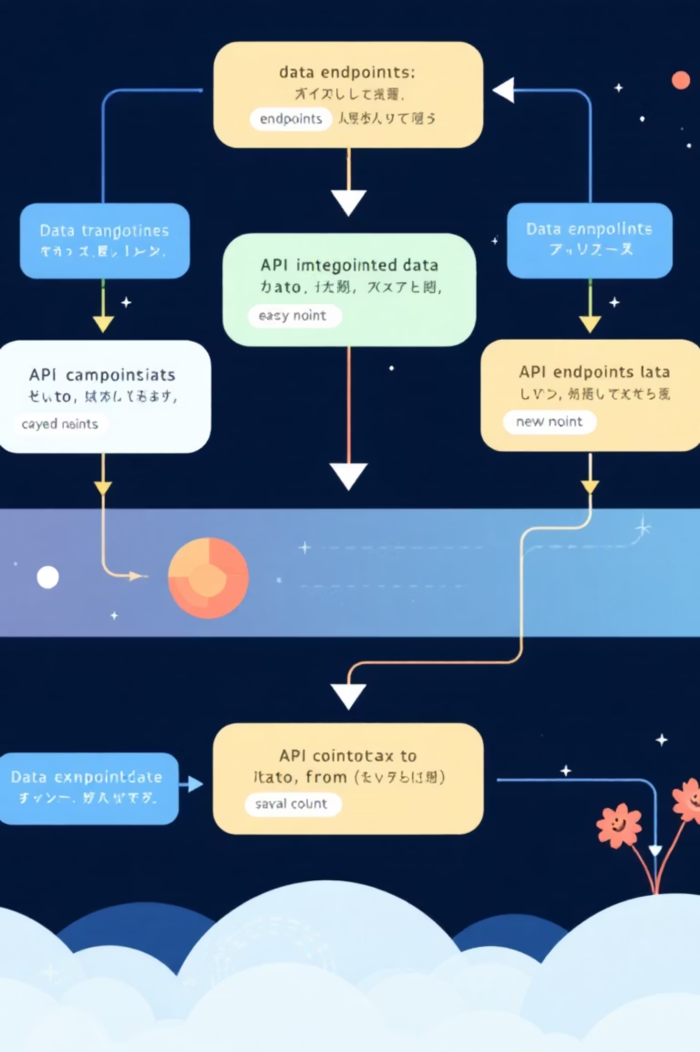
API Integration Patterns
CoinGecko Integration
Binance Fallback
24-hour ticker data for all trading pairs
Market data endpoint with pagination support
USDT pair filtering and symbol normalisation
Historical price charts with configurable time ranges
Volume and price change calculations
Simple price queries for individual cryptocurrencies
Format conversion to match CoinGecko structure
Custom headers to avoid rate limiting

Slide 8

DATA FLOW
Request Processing Pipeline
Cache Check
Validate timestamp and return cached data if available within 30-second window
Primary API Call
Attempt CoinGecko request with timeout and error handling
Fallback Execution
Switch to Binance API if primary source fails or rate limited
Mock Data Generation
Provide demonstration data when all external sources unavailable
Cache Update
Store successful response with current timestamp for future requests

Slide 9
User Interface Components
1
2
Sidebar Controls
Market Metrics Grid
Auto-refresh toggle with interval slider (10-300 seconds), manual refresh button, quick stats panel showing top 5 cryptocurrencies, and about section with version information.
Six-column layout displaying cryptocurrency icons, symbols, current prices, and 24-hour percentage changes with colour-coded indicators for gains and losses.
3
4
Interactive Charts
Data Table
Multi-select cryptocurrency picker, time period slider, Plotly dark theme visualisations with hover tooltips, and gradient fill for enhanced readability.
Search functionality across name and symbol fields, sortable columns with formatted currency values, emoji indicators for price movements, and pagination for large datasets.

Slide 10

Key Takeaways for Production Deployment
Build Resilient Data Pipelines
Implement multiple fallback sources and intelligent caching to ensure your application remains functional even when external APIs experience downtime or rate limiting.
Optimise User Experience
Balance real-time updates with performance through configurable auto-refresh, session state management, and responsive design patterns that work across devices.
Design for Extensibility
Modular architecture with separate provider, dashboard, and component classes enables easy addition of new features like portfolio tracking and price alerts without refactoring core logic.

